Slide 1

Project Presentation
Super Store Sales

Slide 2
Group Members
Omar Khaled Mostafa Hussein (Group Leader)
Ahmed Metwally Mohamed Metwally
Maryam Mohammed Husseini Mohammed
Mennat-Allah Sherif Abdel-Fattah Abdel-Rahman
Mennatullah Aly Mohamed Aly

Slide 3
index
Overview
Cleaning
Data Modeling
Data Analysis
Data Prediction Analysis
Data Visualization
Insights and Recommendations

Slide 4
Super Store Sales Overview
The dataset contains 9,800 records across 18 columns, capturing detailed sales transactions from a retail store. Each row represents a specific product sale and includes information such as:
Order Details: Order ID, Order Date, Ship Date, Ship Mode
Customer Info: Customer ID, Name, Segment, and Location (City, State, Region)
Product Info: Product ID, Name, Category, Sub-Category
Sales Data: Sales amount for each item
The data is ideal for sales analysis, trend forecasting, and identifying customer or product performance patterns across different regions and time periods.

Slide 5
CLEANING
Cleaned the dataset to make it ready for analysis by :
Handling missing values in the Postal Code column
Converted Order Date and Ship Date to datetime format
Converted Postal Code values to string format to ensure consistency
Checked for duplicates and removed any found
Verified all changes and saved the cleaned dataset as a new CSV file
The detailed steps and code used in cleaning will be shown through the Python tool during the presentation

Slide 6
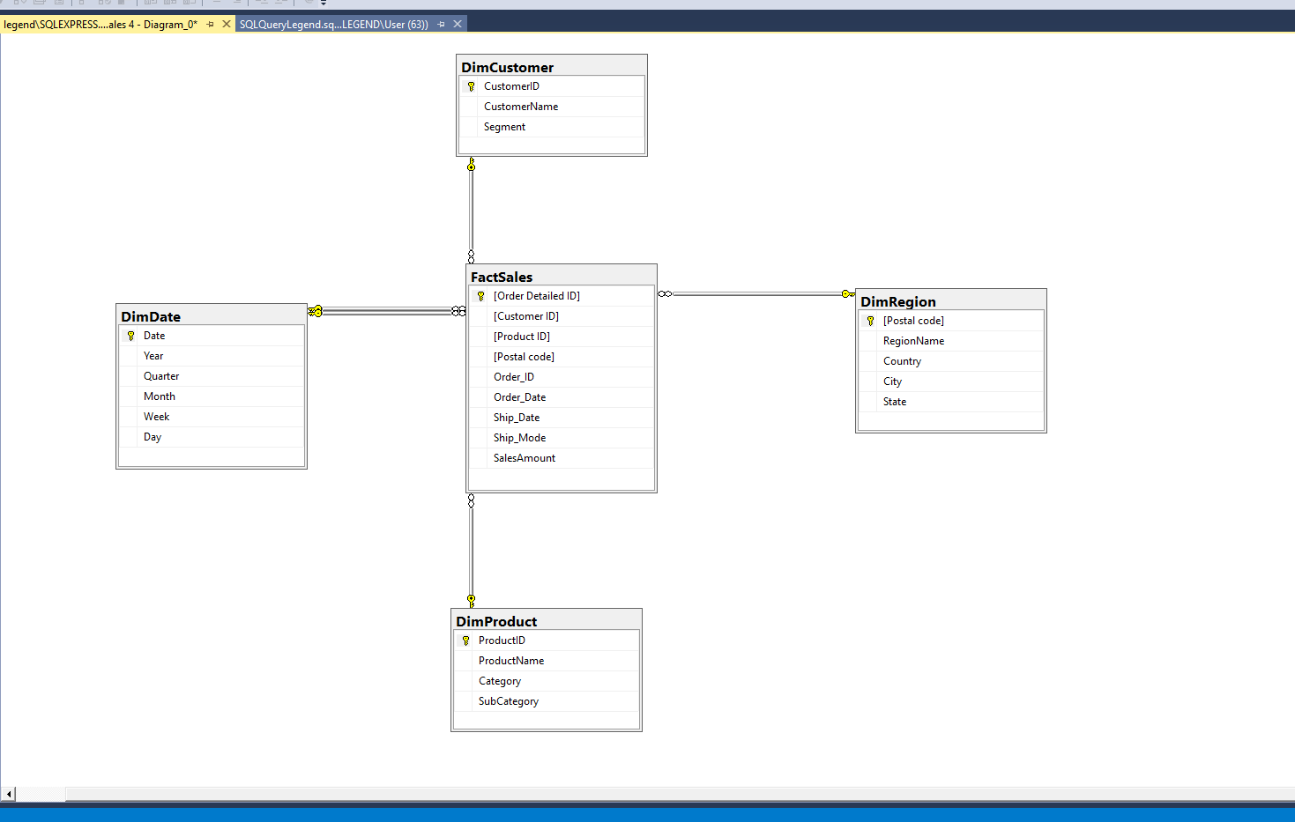
Modeling
Built a Star Schema Data Warehouse from the cleaned dataset, which includes :

Slide 7
Data analysis
Several database views were created to support the analysis shown in this report :
Sales By Year / Quarter / Month: Summarize total sales and number of orders over different time periods to identify trends and seasonality.
Sales By Location: Shows total revenue and order volume across different regions, states, and cities.
Sales By Category: Breaks down sales by product category to highlight best-performing segments.
Late Ship Mode: Focus on shipping delays for "First Class" mode, helping identify cities with frequent late deliveries.
Further details and interactive exploration are available directly within the SQL tool.

Slide 8
PREDICTION ANALYSIS
Predict future sales based on historical yearly sales data
Yearly Sales Analysis : Sales data was grouped by year to observe overall trends
Forecasting Future Sales : A linear regression model was used to predict sales for the next 3 years based on past data
Year-over-Year Growth : Growth percentages were calculated to see how sales increased or decreased each year
Regional Sales Analysis : Sales were analyzed by year and region to identify strong and weak areas
The full explanation, including code details and visualizations is available in the tool

Slide 9
Data visualization
A set of Dashboards has been prepared to analyze business performance, including :
Sales and Growth Dashboard : Tracks monthly sales growth and distribution by customers and regions.
Customer Dashboard : Analyzes customer retention rates and the highest-spending customers.
Products and Shipping Dashboard : Displays the best-selling products and shipping methods.
Details are available in the tool

Slide 10
INSIGHTS AND RECOMMENDATIONS
Insights
Consistent Sales Growth (2015–2018) : Sales increased steadily year over year, indicating a healthy upward trend.
Uneven Year-over-Year Growth : Growth rates vary significantly. Some years strong, others flat or declining.
Technology Dominates in Revenue : Technology products lead in sales, far exceeding Furniture and Office Supplies.
Sales Concentration by Location : reveals some regions , states , cities contribute more significantly to sales volume than others.
Recommendations
Plan for Expansion Based on Forecasts: Use predicted future growth (2019–2021) to scale operations strategically.
Analyze Growth Fluctuations : Investigate what caused inconsistent growth and refine business strategies accordingly.
Promote High-Margin Categories : Focus efforts on technology products to drive revenue and margin growth.
Region-Specific Marketing : Reinforce marketing in high-performing cities and develop targeted promotions in low-sales locations.

